Slide 1



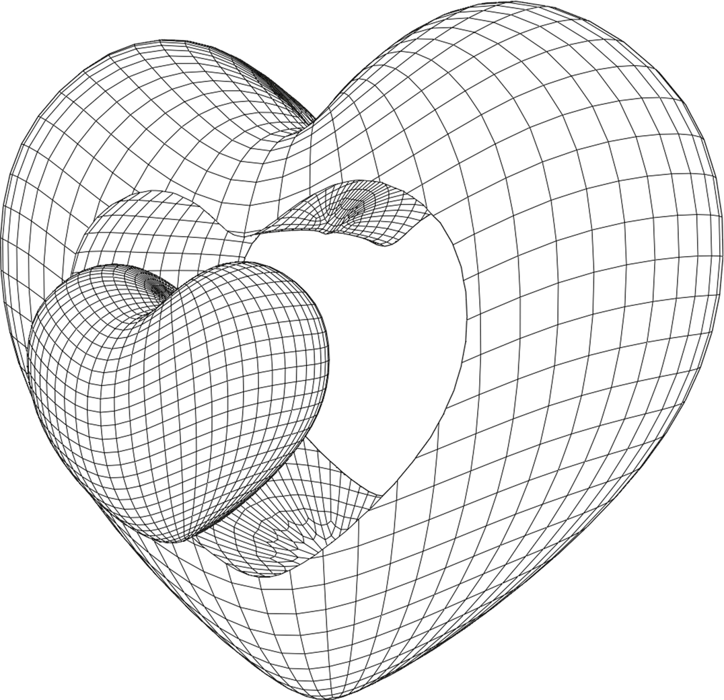
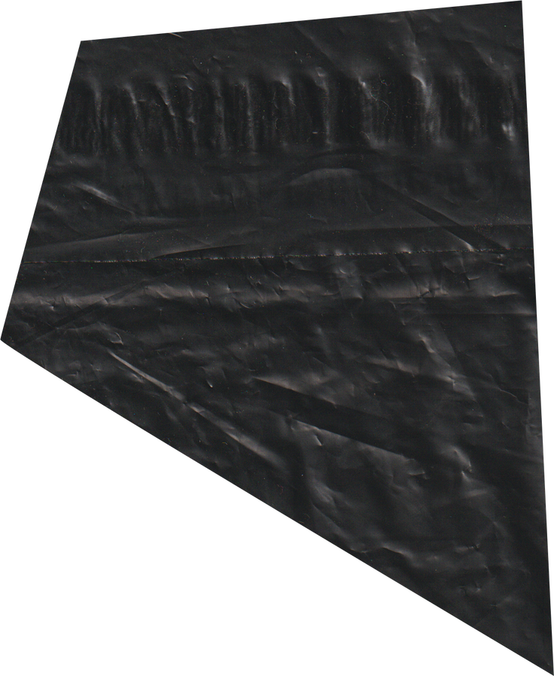

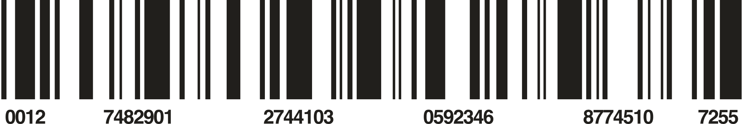
@REALLYGREATSITE
WINTER 2030
BORCELLE
BUILD A WEBSITE SELLING CLOTHES USING SPRING BOOT AND THYMELEAF
REPORT
BORCELLE

Slide 2
@REALLYGREATSITE
CONTENT
1
IMPLEMENTATION PLAN
5
DATA DESIGN
2
TECHNOLOGY OVERVIEW
6
USER INTERFACE
3
SYSTEM SURVEY
7
CONCLUDE
4
USECASE
8
REFERENCES
BORCELLE
2/11

Slide 3
@REALLYGREATSITE
REASONS FOR CHOOSING THE TOPIC
In this context, the project to build a clothing website not only aims to create a user-friendly and easy-to-use interface but also emphasizes providing quality products and customer service. Dedicated customer care and the safest and most convenient online shopping experience.
Building a clothing website is not simply about product presentation, but also requires a delicate combination of user-friendly design, smooth shopping experience, and product management system. flexible products. Every smallest detail, from product display to payment process, needs to be carefully considered to create the best shopping experience for users.
BORCELLE
4/11

Slide 4


@REALLYGREATSITE
01. IMPLEMENTATION PLAN
The implementation plan includes time and working content of the project as detailed in the table, each milestone is 10 days equivalent to 7 milestones.
BORCELLE
3/11

Slide 5
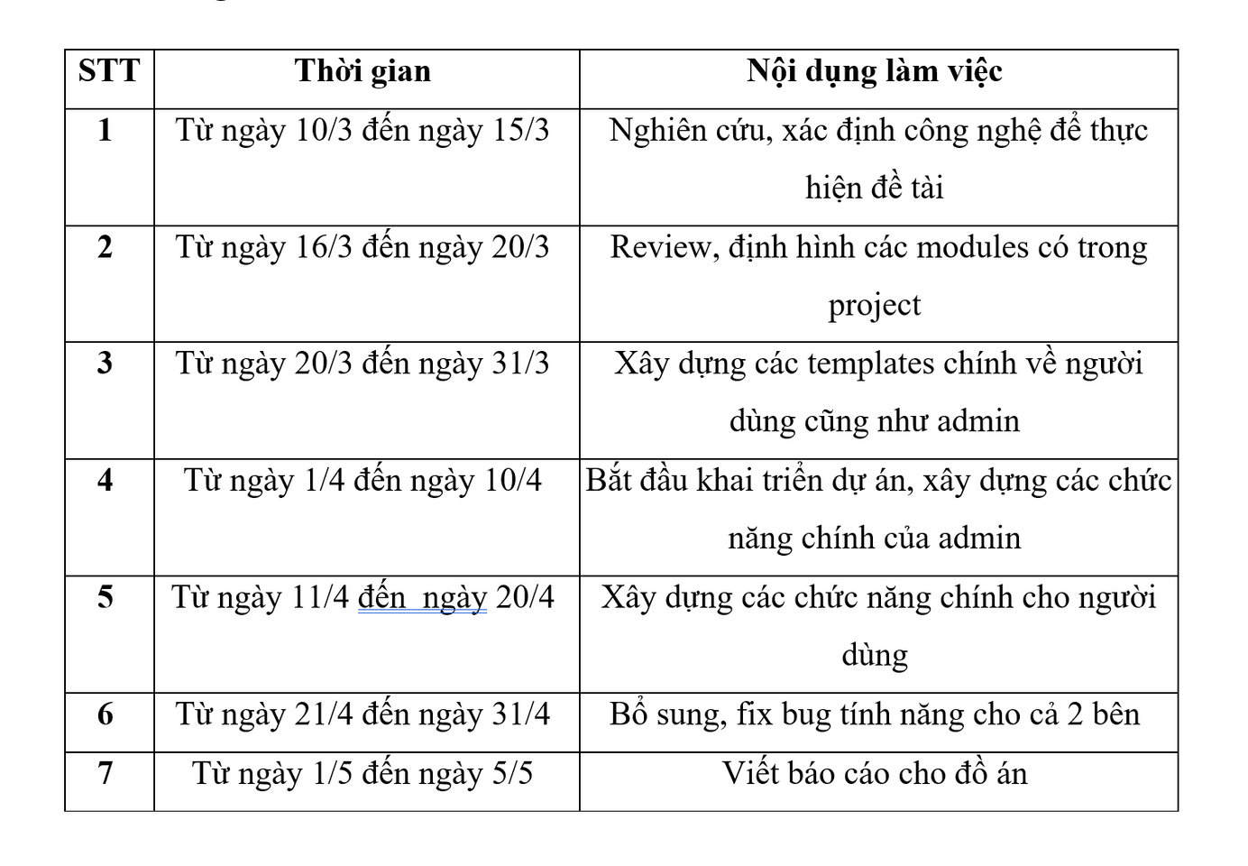

@REALLYGREATSITE
WINTER 2030
BORCELLE
11/11

Slide 6
@REALLYGREATSITE
2. TECHNOLOGY OVERVIEW
2.1 Overview of Spring, Spring Framework in Java
2.2 Overview of Thymeleaf, Spring boot combined with Thymeleaf
2.3 Another technology
BORCELLE
3/11

Slide 7
@REALLYGREATSITE
2.1 OVERVIEW OF SPRING, SPRING FRAMEWORK IN JAVA
2.1.1 What is spring boot?
2.1.2 Spring Framework modules and architecture
2.1.3 Main benefits of Spring Framework
BORCELLE
3/11

Slide 8
@REALLYGREATSITE
2.1.1 WHAT IS SPRING BOOT?
Spring Framework comes from its own ideas and builds on its core. New modules are created based on previous Spring projects to improve functionality, more automatic upgrades, and more powerful configurations in different situations. Different is also the same idea.
The project can select the necessary modules and add them. The central part of the modules is the Spring Core container, which includes configuration templates and a dependency injection mechanism.
Spring Framework provides different application architectures including: communication, data manipulation and web.
BORCELLE
3/11

Slide 9
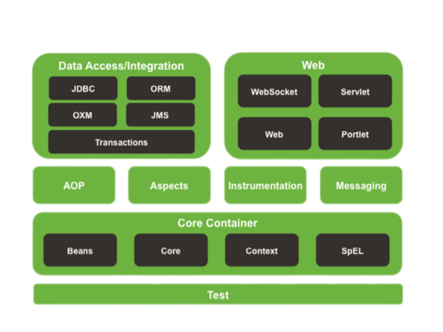
@REALLYGREATSITE
2.1.2 SPRING FRAMEWORK MODULES AND ARCHITECTURE?
2.1.2.1 Core Container
2.1.2.2 Data Access/Integration
2.1.2.3 Web
2.1.2.4 Another modules

Slide 10
@REALLYGREATSITE
2.1.2.1 CORE CONTAINER
Core Container includes modules: spring-core , spring-beans, spring-context, springcontext-support, and spring-expression (Spring Expression Language).
- The spring-core and spring-beans modules provide the basic parts of the framework, including IoC and Dependency Injection.
- The spring-context module builds on a solid foundation provided by the Core and Beans modules, which are used to access objects in the framework-style similar to registering a JNDI.
- The spring-expression module provides a powerful Expression Language for querying and computing an object graph at runtime. It is inherited and extended from unified expression language (unified EL).
-Module spring-jms chứa các tính năng tạo và sử dụng các message. Từ Spring Framework 4.1, nó được tích hợp với spring-messaging.
- The spring-transaction module supports programmatic and declarative transaction management for classes that implement special interfaces and for all your POJOs.

Slide 11
@REALLYGREATSITE
2.1.2.2 DATA ACCESS/INTEGRATION
Data Access/Integration includes JDBC, ORM, OXM, JMS and Transaction modules.
- The spring-jdbc module provides a JDBC-abstraction class to eliminate tedious JDBC code and analyze database-vendor specific error codes.
- The spring-orm module provides an integration layer with popular orm APIs such as JPA, JDO and Hibernate.
- The spring-oxm module provides an abstraction layer that supports Object/XML mapping implementations such as AXB, Castor, XMLBeans, JiBX and XStream.
- The spring-jms module contains features for creating and using messages. From Spring Framework 4.1, it is integrated with spring-messaging.
- The spring-transaction module supports programmatic and declarative transaction management for classes that implement special interfaces and for all your POJOs.

Slide 12
@REALLYGREATSITE
2.1.2.3 WEB
The Web layer includes the spring-web , spring-webmvc, spring-websocket and springwebmvc-portlet modules.
- The spring-web module provides basic web-oriented integration features such as multipart file upload functionality and instantiation of IoC containers using servlet listeners and a web-oriented application context.
- The spring-webmvc module includes Spring's Model-View-Controller (MVC) implementation for web applications.
- The spring-websocket module provides support for WebSocket-based, two-way communication between client and server in web applications.
The springwebmvc-portlet module provides an MVC implementation used in the portlet environment and maps the functionality of the Web-Servlet module.

Slide 13
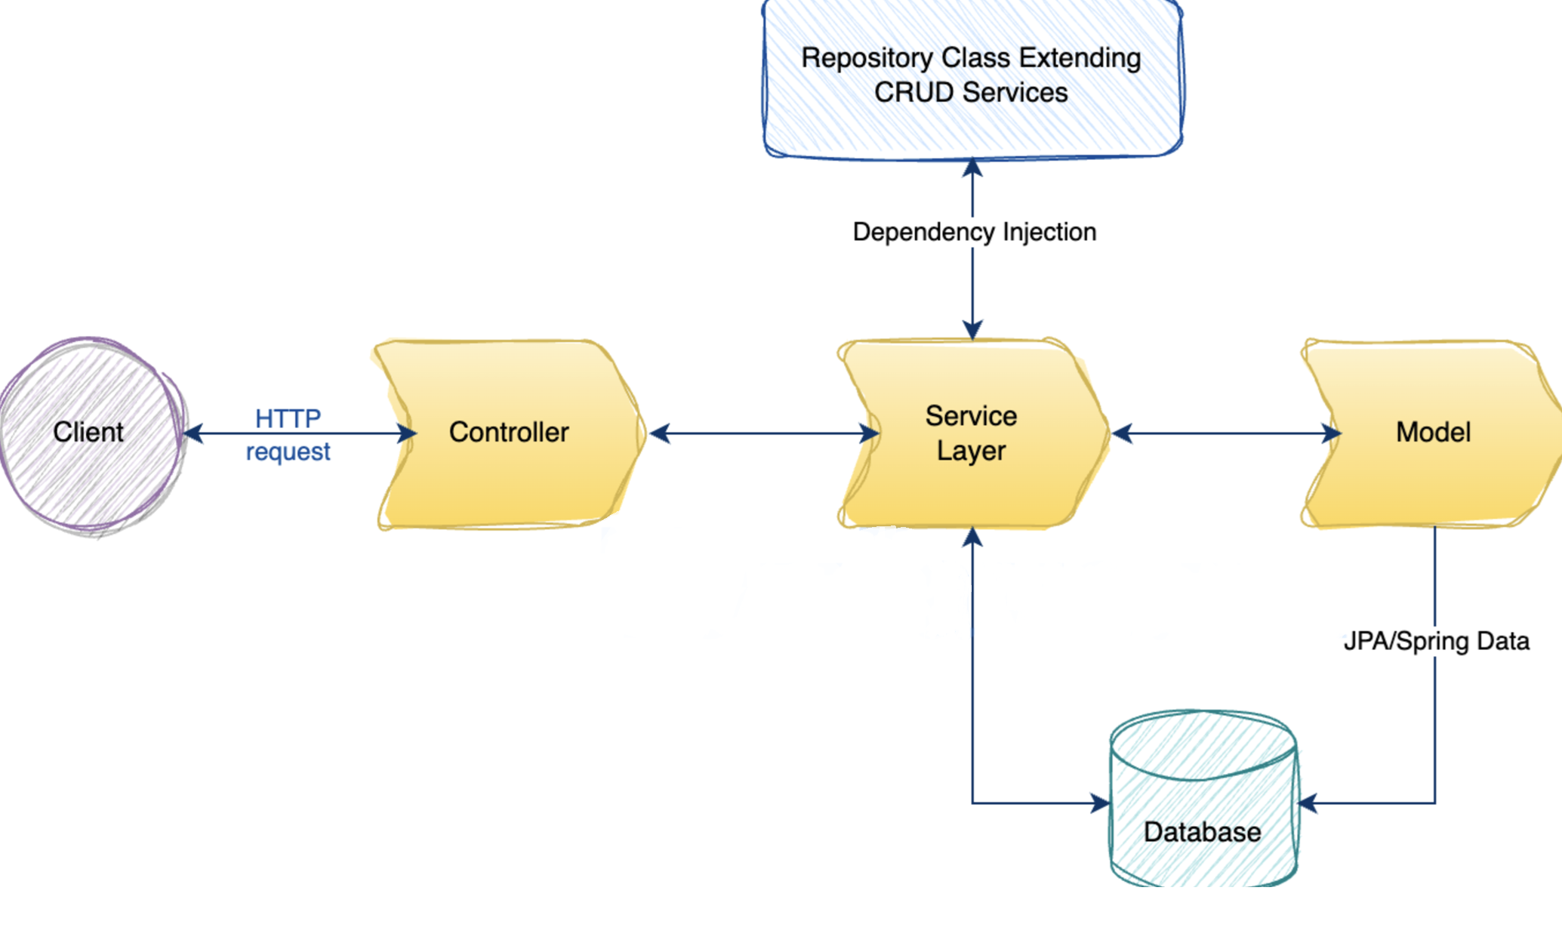















@REALLYGREATSITE
FLOW DIAGRAM

Slide 14
@REALLYGREATSITE
2.2 OVERVIEW OF THYMELEAF, SPRING BOOT COMBINED WITH THYMELEAF
2.2.1 What is Thymeleaf?
2.2.2 Advantages of using Thymeleaf
BORCELLE
3/11

Slide 15
@REALLYGREATSITE
2.2.1 WHAT IS THYMELEAF?
Thymeleaf is a Java XML/XHTML/HTML5 Template Engine that can work with both Web and non-Web environments. It is more suitable to be used to serve XHTML/HTML5 on the View Layer of a Web application based on MVC architecture. It can process any XML file, even in offline environments (Not online). It fully supports interaction with Spring Framework.
BORCELLE
3/11

Slide 16
@REALLYGREATSITE
2.2.2 ADVANTAGES OF USING THYMELEAF
- Use HTML as view
Thymeleaf uses HTML tags as views and integrates directly into HTML files. This means you don't need to add "non-HTML" tags to your HTML files.
- Automatically refresh the interface
Usually, to see a change in the look and feel of a website, you need to refresh your browser. Thymeleaf allows you to see changes to the theme without having to reload the website. This increases development performance and helps you see changes immediately.
BORCELLE
3/11

Slide 17
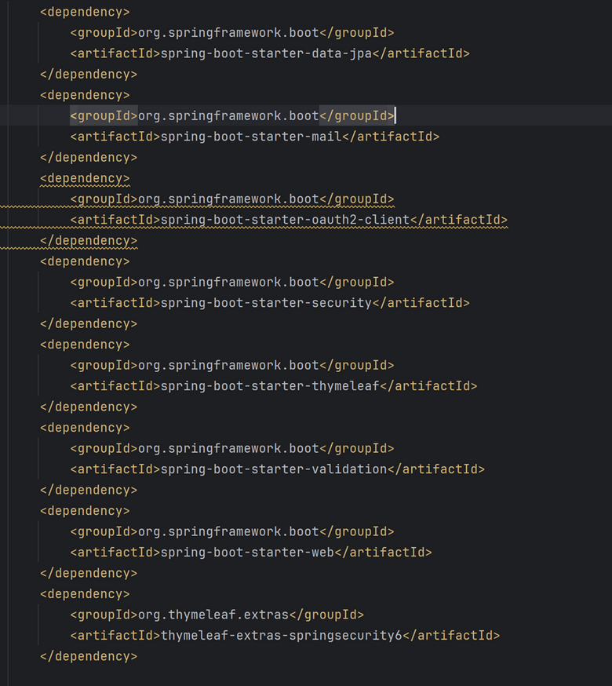
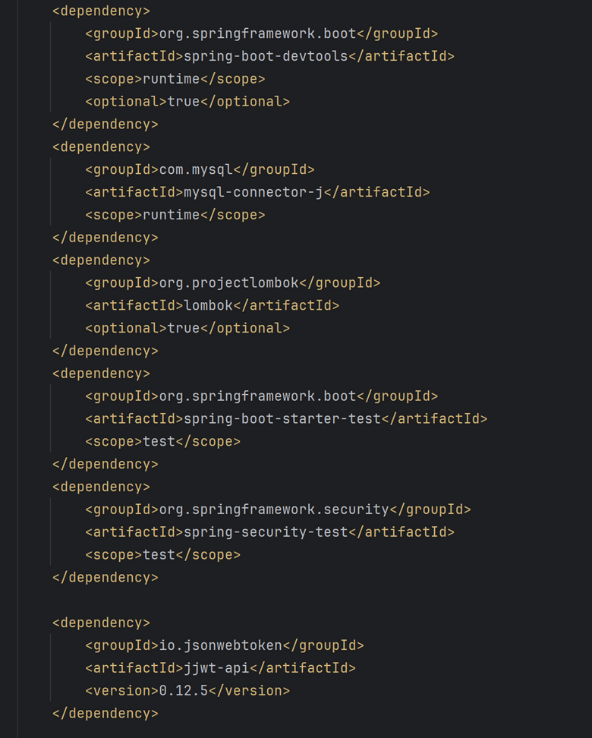
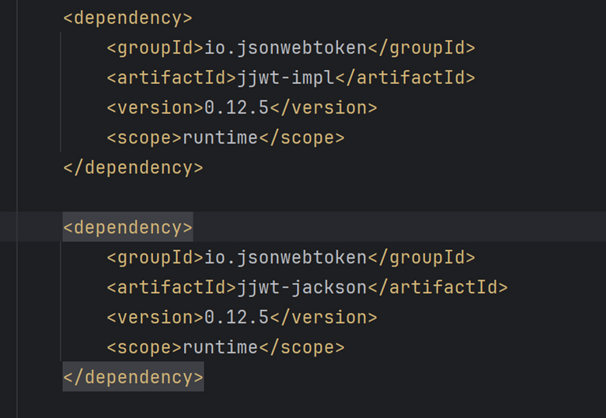
@REALLYGREATSITE
2.3 ANOTHER TECHNOLOGY

Slide 18
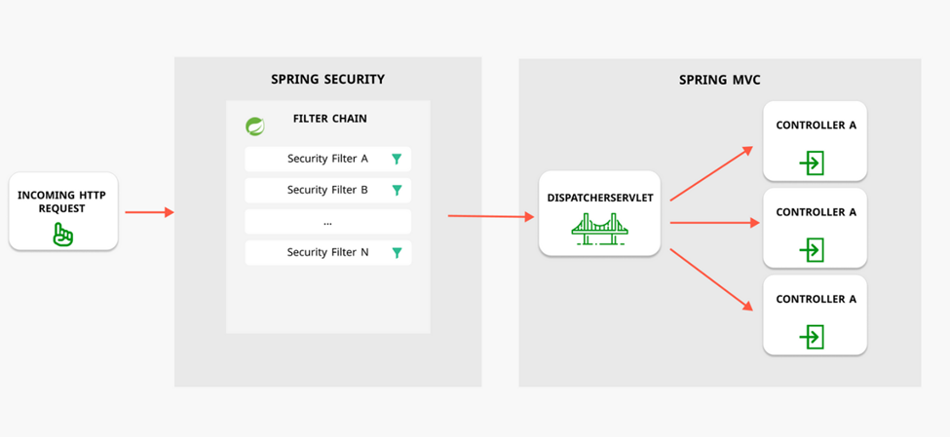
@REALLYGREATSITE
2.3 ANOTHER TECHNOLOGY
Spring Security

Slide 19
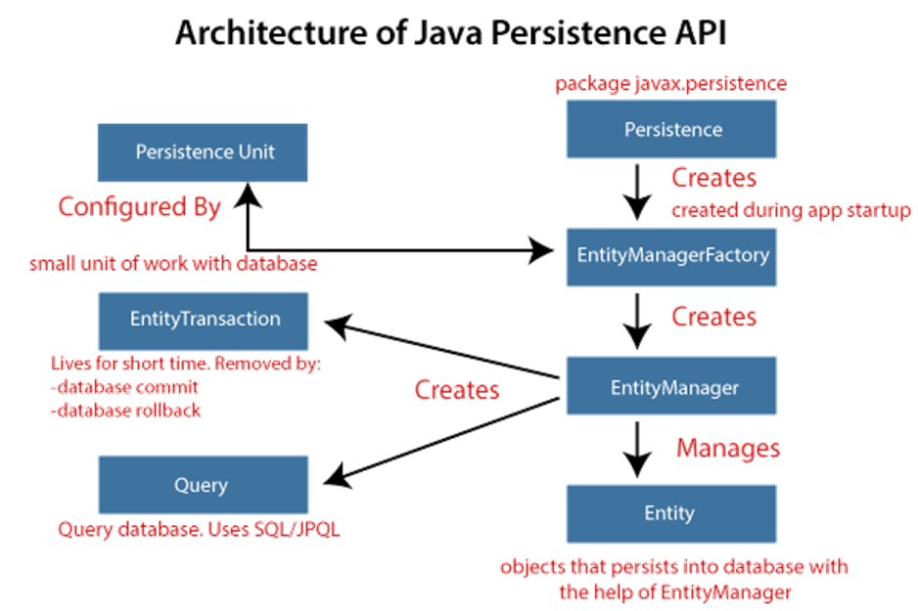
@REALLYGREATSITE
2.3 ANOTHER TECHNOLOGY
JPA (Java Persistence API)

Slide 20
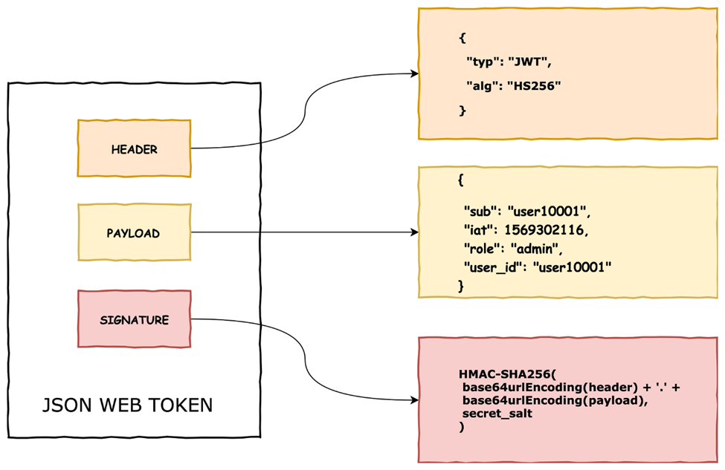
@REALLYGREATSITE
2.3 ANOTHER TECHNOLOGY
JWT

Slide 21
@REALLYGREATSITE
3. SYSTEM SURVEY
The clothing fashion shop system includes 2 pages for customers and administrators. Not only in terms of design, but also includes many necessary functions of a fashion shop system. Full range of clothing categories for customers to choose from including main functions of viewing products, filtering products, searching for products, adding products to cart, payment, etc.
The admin page has the advantage of having an authorization section to ensure the administrator works in accordance with his or her role, including sections on product management, product categories, orders, customers, vouchers, and statistics. Statistics, etc. Brings high performance, quick and effective working productivity but no less accurate and authentic.

Slide 22
@REALLYGREATSITE
4. USECASE
4.1 Customer sitemap
4.2 Administrator sitemap

Slide 23
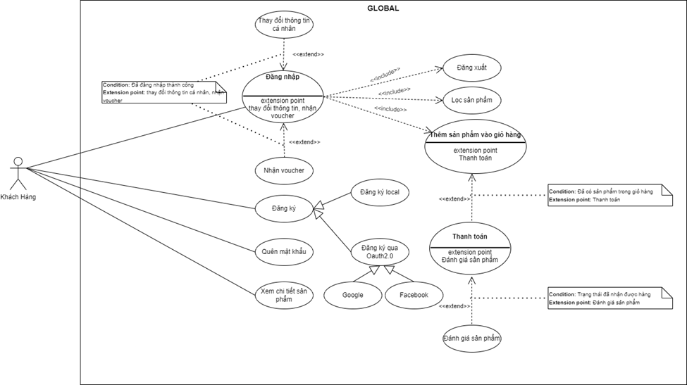
@REALLYGREATSITE
4.1 CUSTOMER SITEMAP
4.1.1 GOLBAL

Slide 24
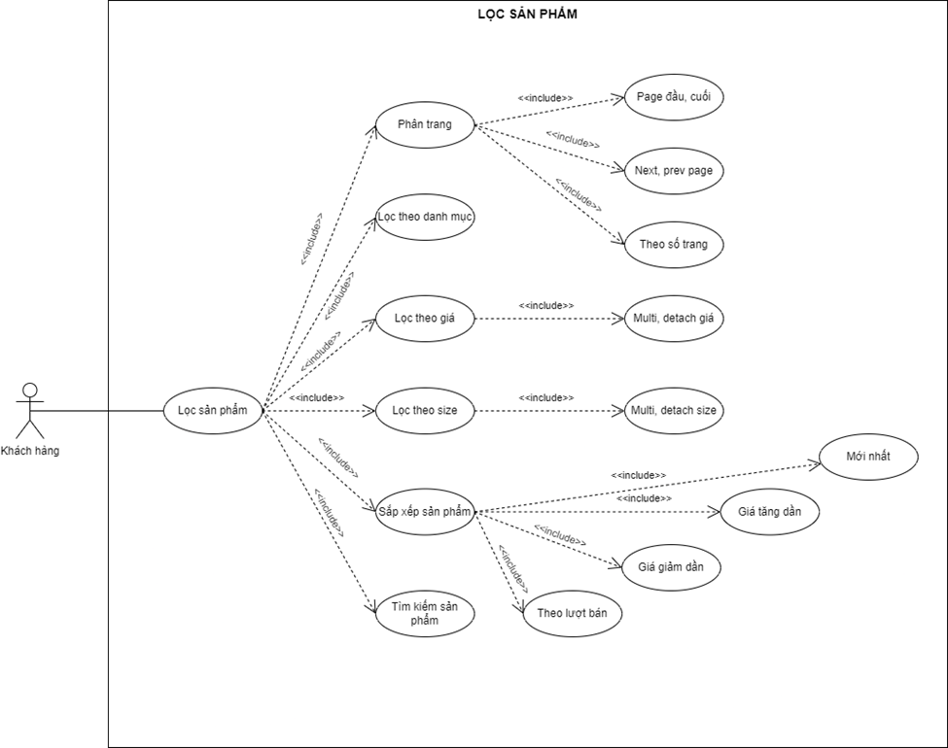
@REALLYGREATSITE
4.1 CUSTOMER SITEMAP
4.1.2. Product filtering diagram

Slide 25
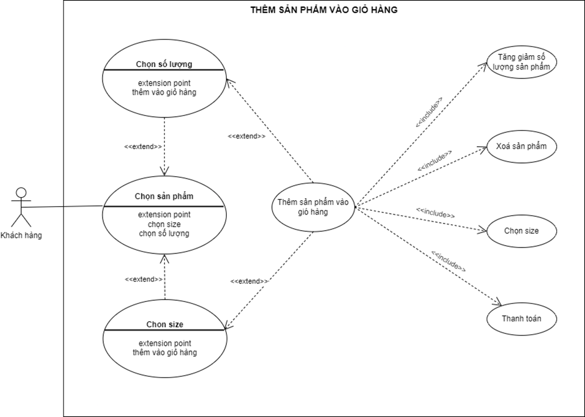
@REALLYGREATSITE
4.1 CUSTOMER SITEMAP
4.1.3. Diagram to add products to cart

Slide 26
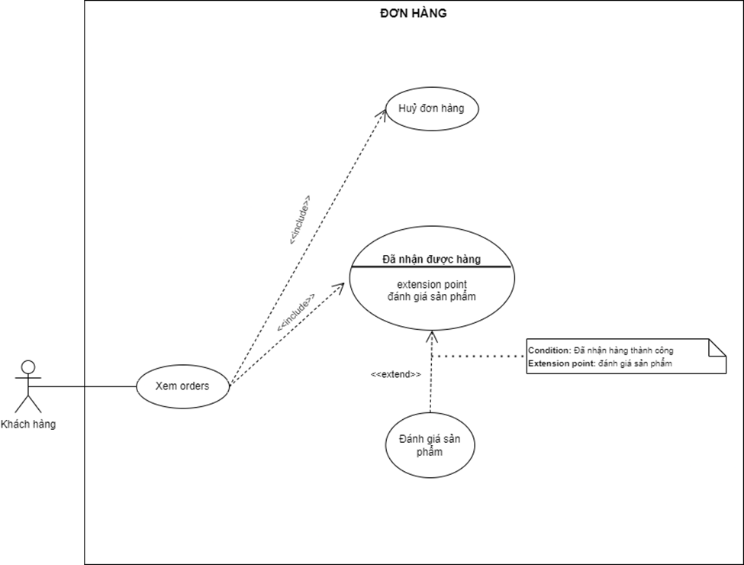
@REALLYGREATSITE
4.1 CUSTOMER SITEMAP
4.1.5. Order diagram

Slide 27
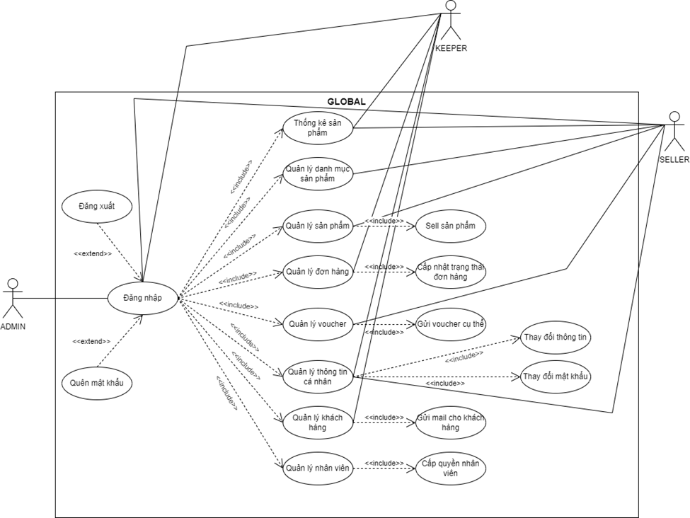
@REALLYGREATSITE
4.2 ADMINISTRATOR SITEMAP
GLOBAL

Slide 28
@REALLYGREATSITE
5. DATA DESIGN
5.1 Relational data model
5.2 Tables contained in the database

Slide 29
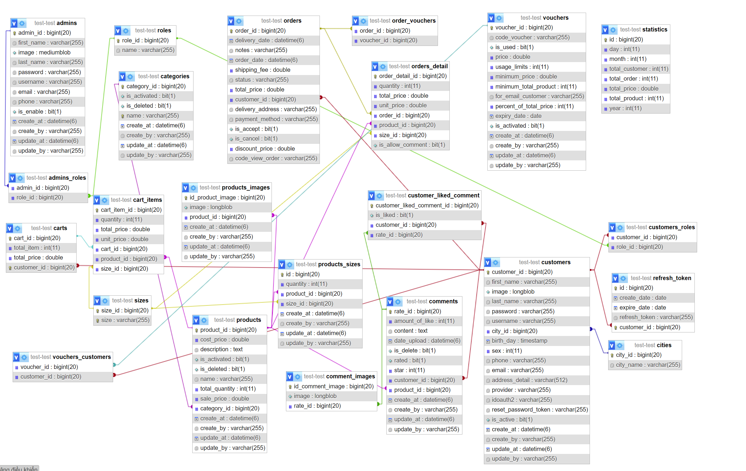
@REALLYGREATSITE
5.1 RELATIONAL DATA MODEL

Slide 30
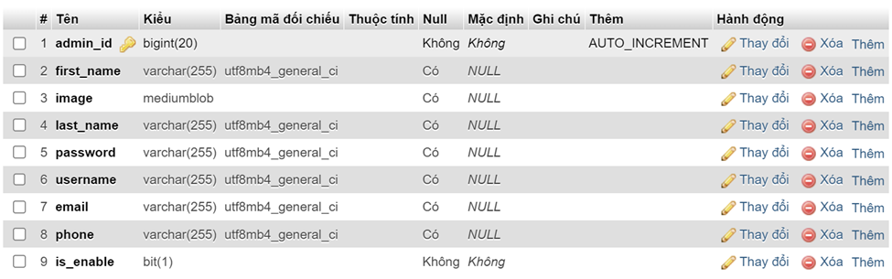
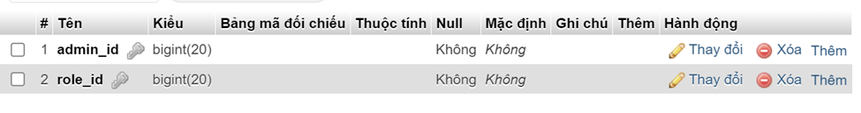
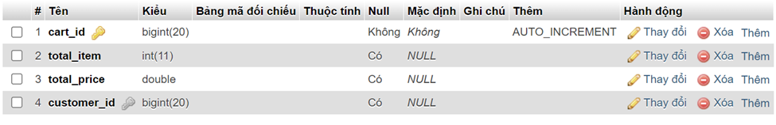
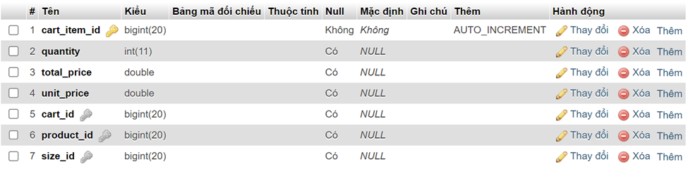
@REALLYGREATSITE
5.2 TABLES CONTAINED IN THE DATABASE
Admin
Admin roles
Cart
Cart item

Slide 31
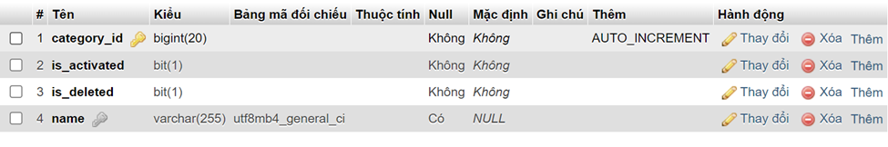
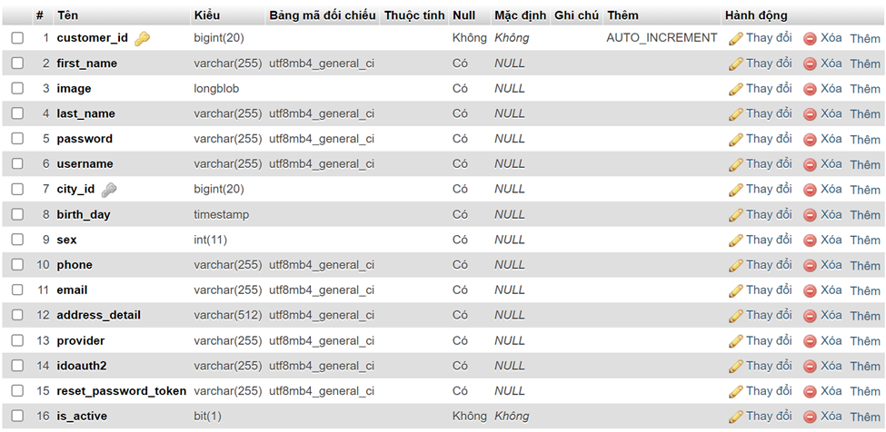
@REALLYGREATSITE
5.2 TABLES CONTAINED IN THE DATABASE
Category
Admin roles
Customer roles

Slide 32
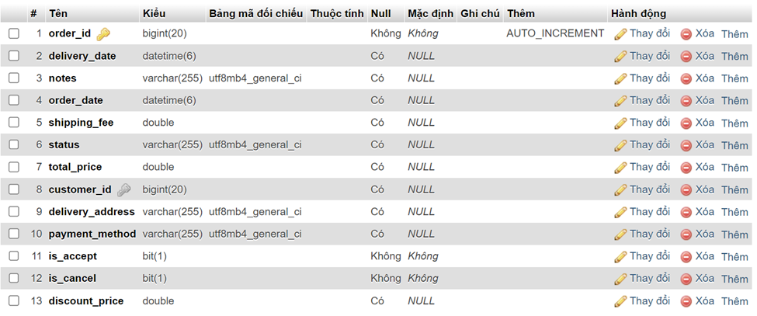
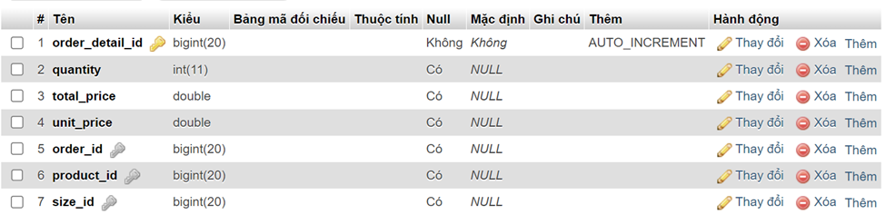
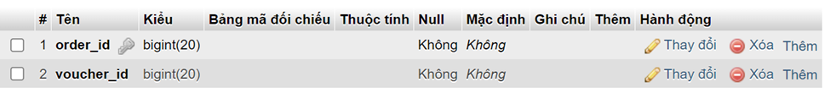
@REALLYGREATSITE
5.2 TABLES CONTAINED IN THE DATABASE
Order
Order detail
Order voucher

Slide 33
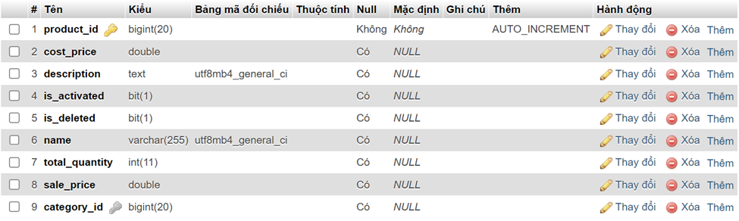
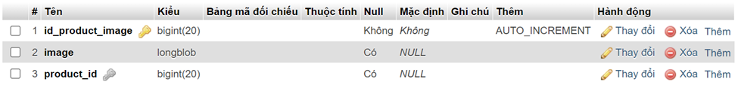
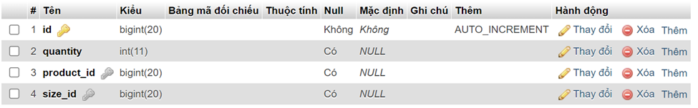
@REALLYGREATSITE
5.2 TABLES CONTAINED IN THE DATABASE
Product
Product images
Product size
Size

Slide 34
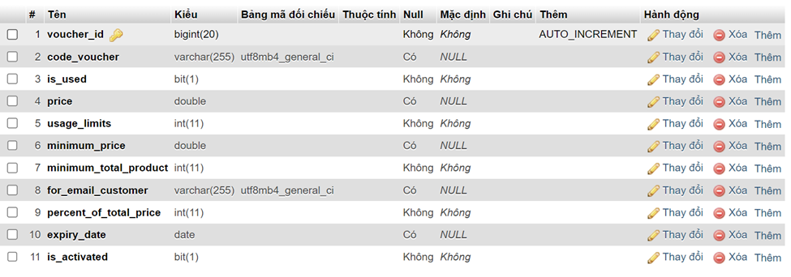
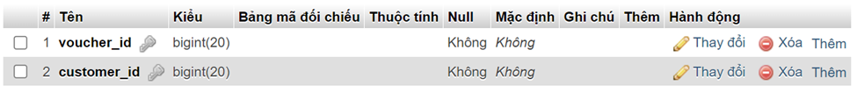
@REALLYGREATSITE
5.2 TABLES CONTAINED IN THE DATABASE
Voucher
Voucher customer

Slide 35
@REALLYGREATSITE
6. USER INTERFACE
6.1 User interface for customers
6.2 User interface for administrator

Slide 36
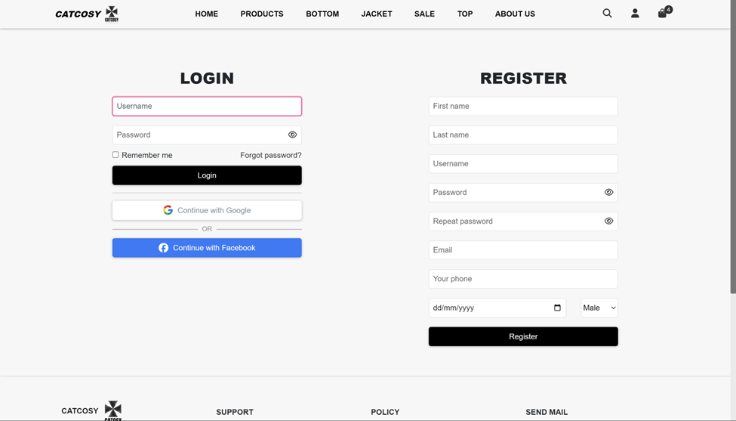
@REALLYGREATSITE
6.1 USER INTERFACE FOR CUSTOMERS
Login and registration page

Slide 37
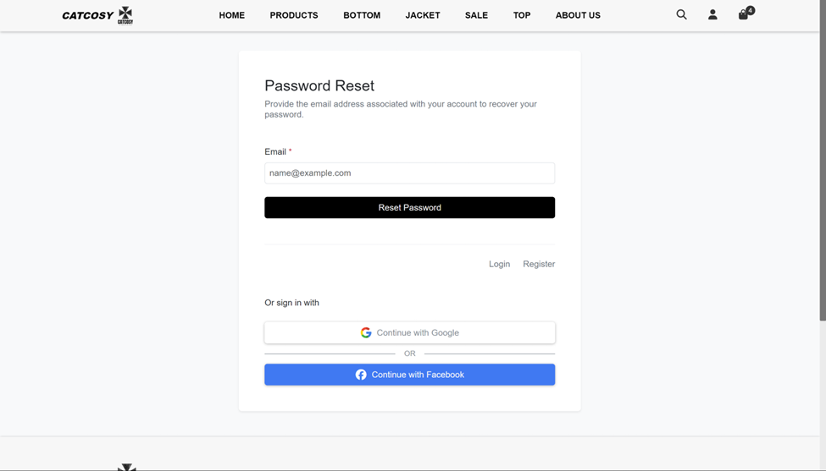
@REALLYGREATSITE
6.1 USER INTERFACE FOR CUSTOMERS
Forgot password page

Slide 38
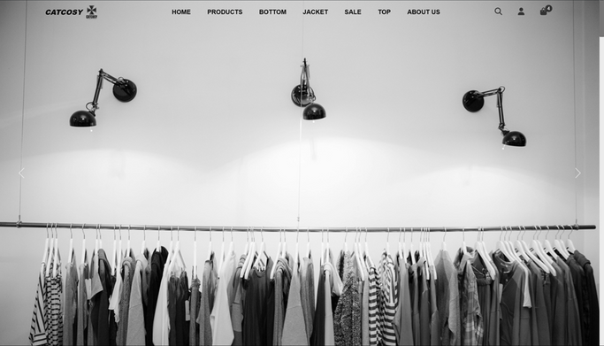
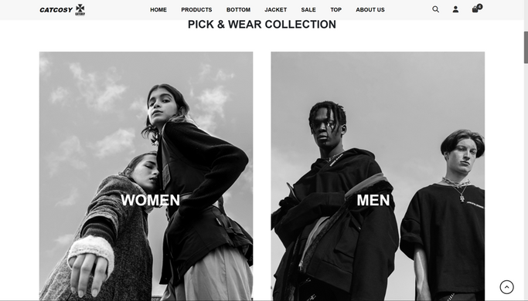
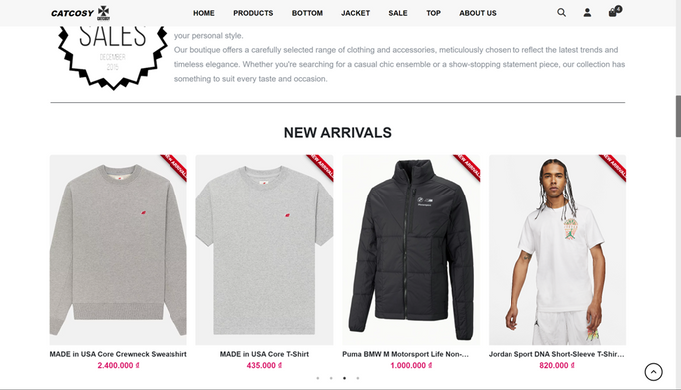
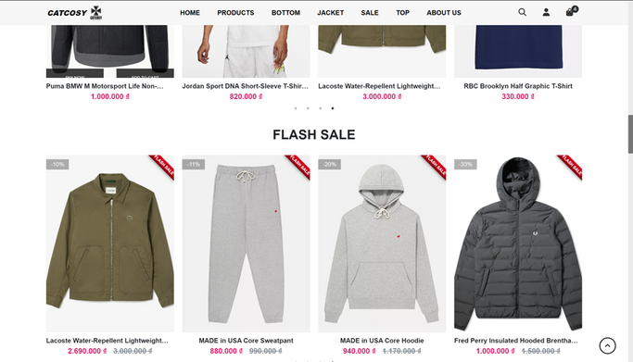
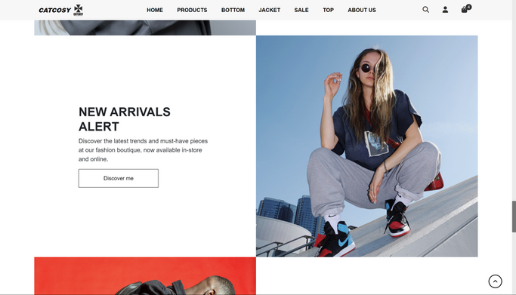
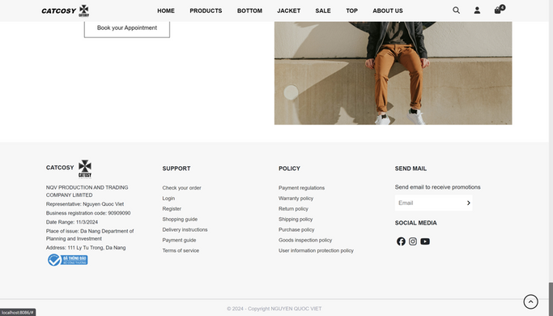
@REALLYGREATSITE
6.1 USER INTERFACE FOR CUSTOMERS
Home page

Slide 39
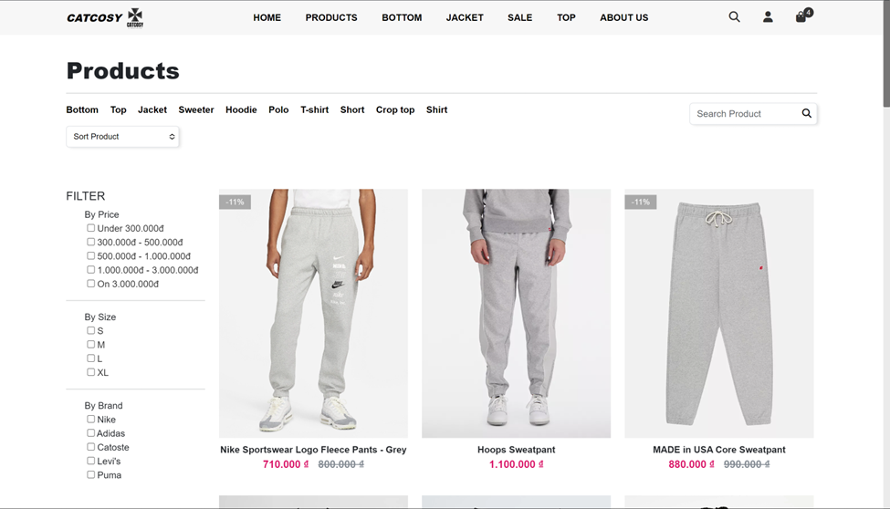
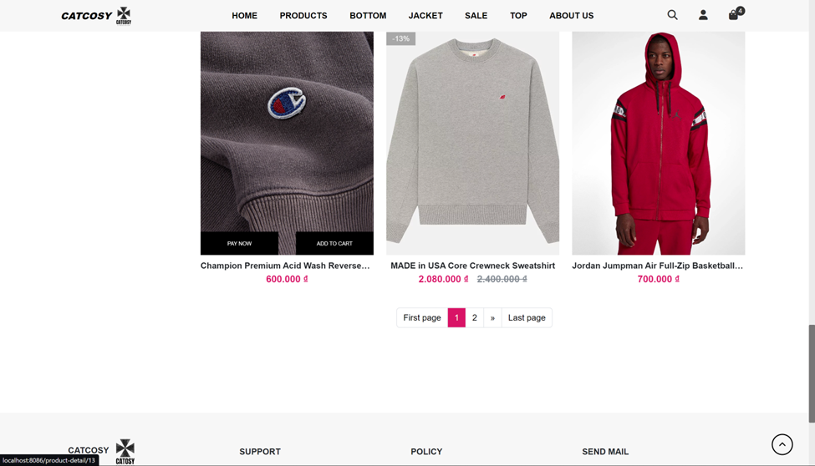
@REALLYGREATSITE
6.1 USER INTERFACE FOR CUSTOMERS
Page product

Slide 40
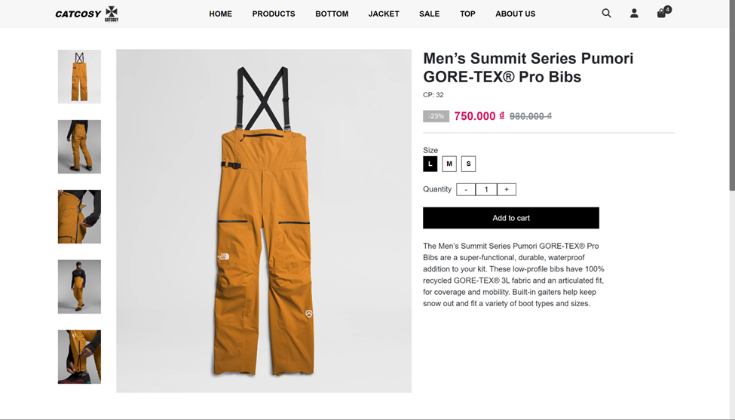
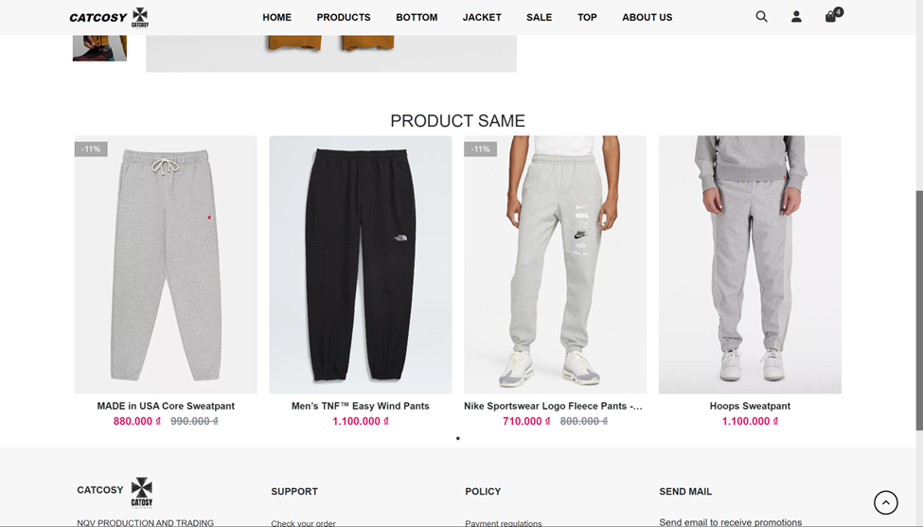
@REALLYGREATSITE
6.1 USER INTERFACE FOR CUSTOMERS
Page product detail

Slide 41
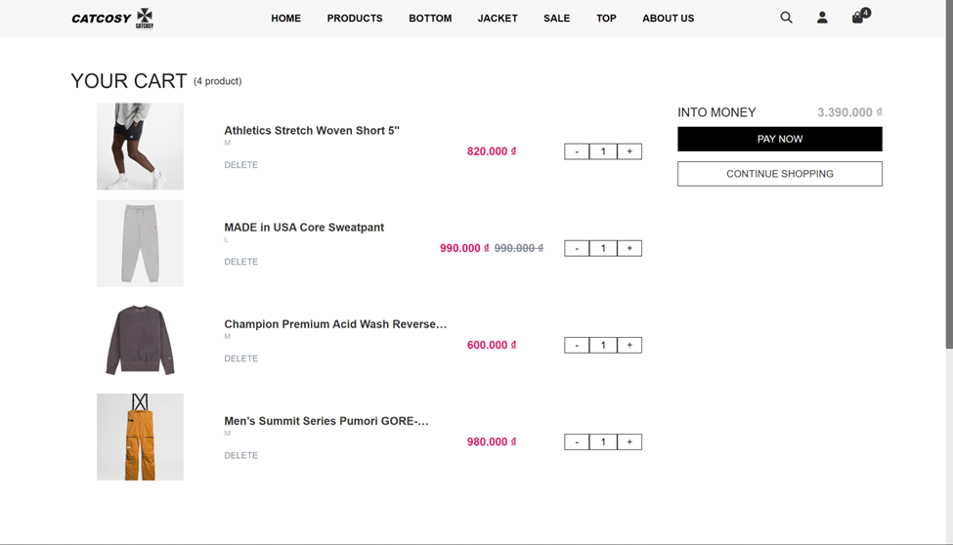
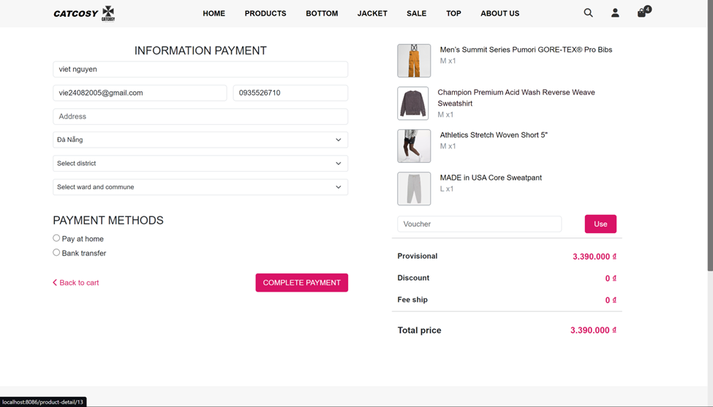
@REALLYGREATSITE
6.1 USER INTERFACE FOR CUSTOMERS
Page cart and page checkout

Slide 42
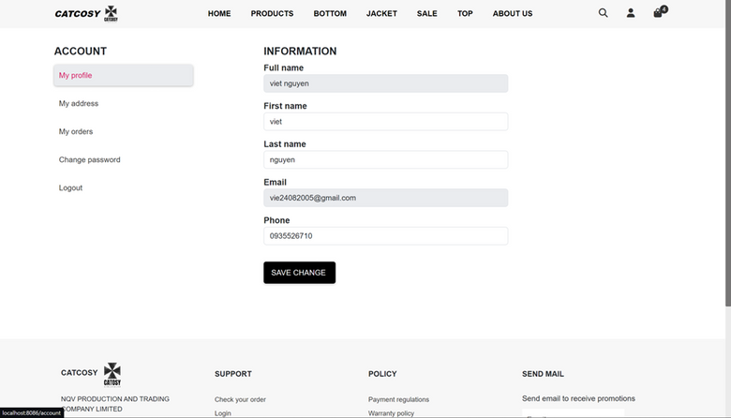
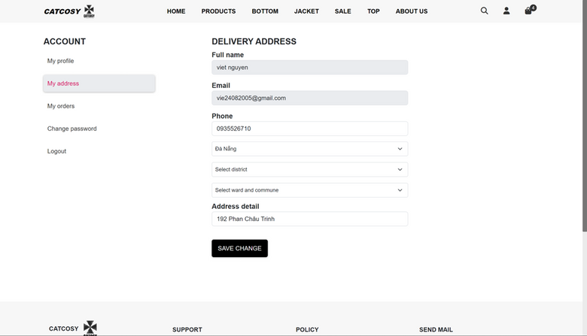
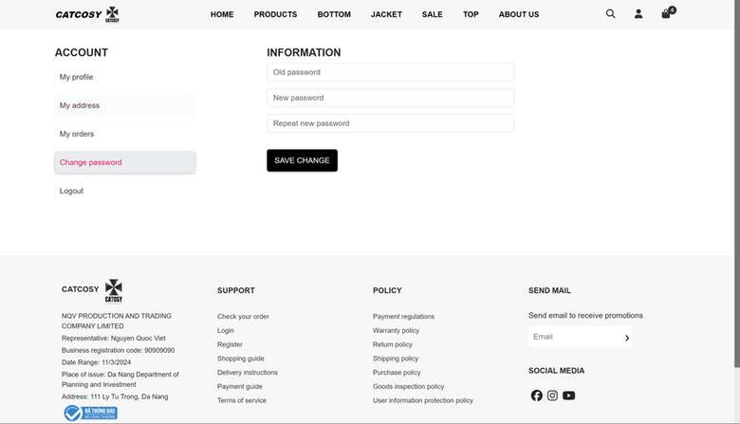
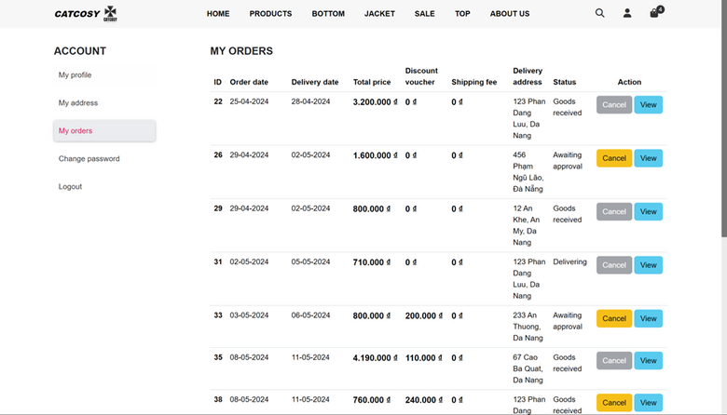
@REALLYGREATSITE
6.1 USER INTERFACE FOR CUSTOMERS
Page account

Slide 43




@REALLYGREATSITE
6.2 USER INTERFACE FOR ADMINISTRATOR
Personal information page
Home page
Product management page
Product category management page

Slide 44




@REALLYGREATSITE
6.2 USER INTERFACE FOR ADMINISTRATOR
Page update product
Page add product
Order management page

Slide 45



@REALLYGREATSITE
6.2 USER INTERFACE FOR ADMINISTRATOR
Customer management page
Voucher management page
Employee management page

Slide 46
@REALLYGREATSITE
7. CONCLUDE
Srping boot is a powerful framework, it helps us develop a website quickly with high demand today. Developing a sales website quickly in time for customers Spring boot is not a bad choice. Especially Spring security with full support technology for security and safety of use such as JWT, Oauth2.0,...
This is my first basic project, with limited human resources and limited time, but during the implementation process, there were times when I encountered many difficulties for someone starting from scratch. 0 Completing this project is very satisfying for me. If there is anything lacking in this topic, I hope teachers will sympathize and give suggestions so that this topic can be further developed.
Thank you sincerely.

Slide 47
@REALLYGREATSITE
8. REFERENCES
[1] https://docs.spring.io/spring-boot/docs/3.2.2/reference/htmlsingle/#web.spring-session
[2] https://www.youtube.com/watch?v=5rNk7m_zlAg
[3] https://kungfutech.edu.vn/khoa-hoc/spring-boot
[4] https://viblo.asia/search?q=spring%20boot
[5] https://www.bezkoder.com/?s=spring+boot&submit=Search

Slide 48
@REALLYGREATSITE
WINTER 2030
THANK YOU
BORCELLE
11/11

